Slide 1
INFORMATION TECHNOLOGY
DEBKANTA NANDI

Slide 2
Our Contents
Introduction of Information Technology and Business systems.
Data Types,Sources,and Lifecycle.
Introduction to Business Analyst Role.
Data vs. Information.
Overview of Data Driven Decision Making.
Case Discussions / Real-Life Examples.
Introduction to Data Governance & Data Ethics.

Slide 3
1. Introduction to Information Technology and Business systems.

Slide 4
1.1 Fundamentals of Information Technology
Information Technology (IT) refers to the use of computers, software, networks, and other digital systems to store, process, transmit, and manage information.
Simple Definition
Information Technology is the technology used to handle data and information electronically.
In short:
Information Technology helps people and organizations work faster, store information safely, and communicate easily using digital tools.

Slide 5
Simple difference between IT between computer.
Simple Difference
IT = Using and managing technology
CS = Creating and improving technology
Example
If you develop a mobile app → Computer Science
If you install, maintain, and secure the app on company systems → Information Technology

Slide 6
Components of Information Technology.
Main Components of IT
Hardware: Physical devices such as computers, keyboards, printers, servers, and routers.
Software: Programs and applications like operating systems, MS Office, web browsers, and mobile apps.
Networking: Connecting devices to share data using LAN, WAN, Wi-Fi, and the Internet.
Data: Raw facts and information stored and processed by computer systems.

Slide 7
Types of Software
System Software and Application Software
System Software
  Controls and manages computer hardware.
  Examples: Windows, Linux, macOS.
Application Software
  Helps users perform specific tasks.
  Examples: MS Word, Excel, PowerPoint, web browsers, accounting software.
Utility Software
  Maintains system performance.
  Examples: Antivirus, disk cleanup tools.

Slide 8
Networking and Internet
Role of Networking in IT
Networking allows computers to communicate and share resources.
Types of networks:
  LAN (Local Area Network)
  WAN (Wide Area Network)
The Internet is a global network connecting millions of devices.
Common Internet services: Email, websites, cloud computing, video conferencing, and online learning.

Slide 9
Importance and Applications of IT
Why Information Technology is Important
Improves communication and collaboration.
Increases business efficiency and productivity.
Enables digital services like e-commerce and online banking.
Supports data storage, analysis, and decision-making.
Used in various sectors: Education, healthcare, government, finance, and entertainment.

Slide 10
1.2 The role of information technology in modern business.
Enhancing Efficiency and Operations for Business Efficiency and Automation
Automates routine tasks such as accounting, payroll, inventory, and order processing
Improves productivity through business software (ERP, CRM, HRM systems)
Enables real-time data collection and analysis for faster decision-making
Supports remote work and collaboration using cloud computing, email, and video conferencing
Reduces operational costs by minimizing manual work and errors
Improves supply chain management through tracking, forecasting, and logistics optimization

Slide 11
Driving Growth and Competitive Advantage for Innovation and Customer Engagement
Enhances customer experience through e-commerce, mobile apps, and online services
Enables digital marketing via social media, SEO, and data-driven advertising
Provides business insights using data analytics, AI, and business intelligence tools
Supports innovation by enabling new products, services, and digital business models
Improves communication with customers and partners worldwide
Strengthens data security and risk management through cybersecurity solutions.

Slide 12
1.3 Overview of Business Systems.
Business systems are integrated software solutions that support and manage organizational operations
They help automate processes, store data, and improve coordination across departments
Common types of business systems include:
ERP (Enterprise Resource Planning) – manages finance, HR, inventory, procurement, and operations
CRM (Customer Relationship Management) – manages customer data, sales, marketing, and service
SCM (Supply Chain Management) – manages suppliers, production, logistics, and distribution
HRM (Human Resource Management Systems) – handles recruitment, payroll, and employee records
Provides centralized data and real-time information for effective decision-making

Slide 13
Business Value and Benefits
Improves operational efficiency through automation and standardized workflows
Enhances data accuracy and reduces duplication or manual errors
Supports better planning and strategic decision-making using reports and analytics
Improves collaboration and information sharing between departments
Enhances customer satisfaction through faster service and personalized interactions
Helps organizations scale, reduce costs, and maintain a competitive advantage

Slide 14
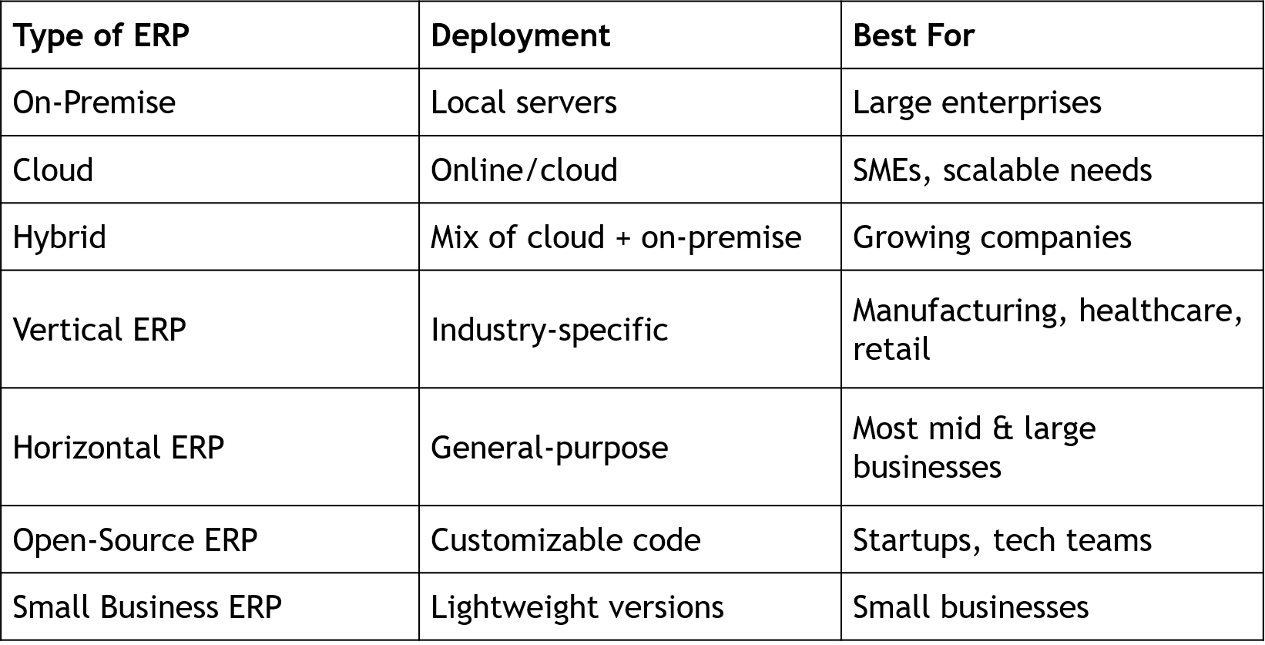
Types of ERP

Slide 15
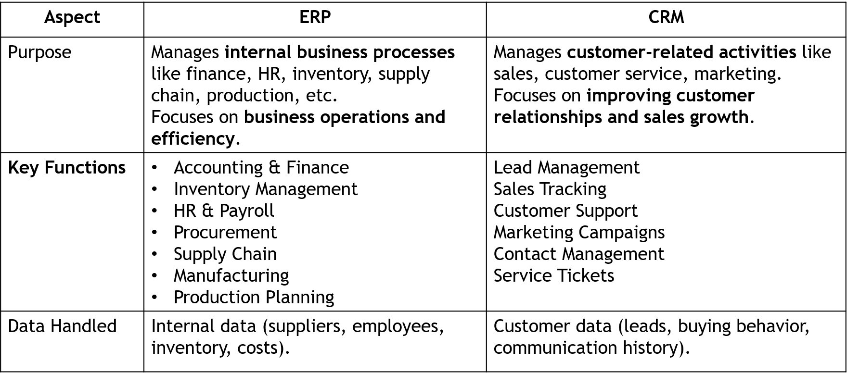
ERP vs CRM

Slide 16
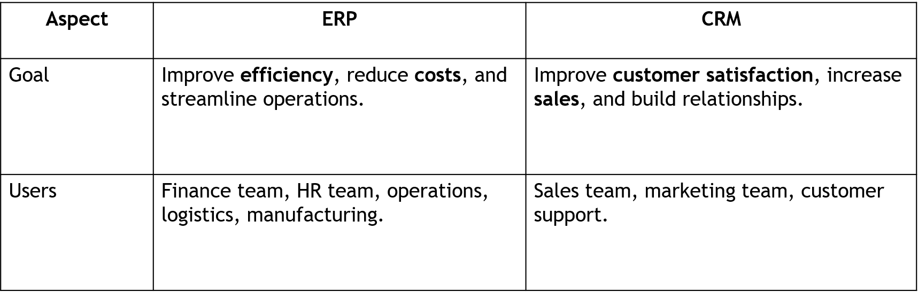

Slide 17
1.4 Interplay Between IT and Business Strategy
Aligns IT initiatives with business goals to support growth, efficiency, and competitive advantage
IT enables business strategy through digital transformation, automation, data analytics, and innovation
Business strategy guides IT investments, priorities, and technology adoption
Data-driven insights from IT systems support strategic planning and decision-making
Integrated IT infrastructure improves agility, scalability, and faster response to market changes
Collaboration between business leaders and IT teams ensures value creation and effective resource use
Strategic use of technologies such as cloud computing, AI, and cybersecurity strengthens long-term
business performance

Slide 18
2. Data Types,Sources,and Lifecycle

Slide 19
2.1 Understanding Different data types
(Structured,Semi-structured,Unstructured)
1. Structured Data
Definition:
Structured data is organized in a fixed format with a predefined schema (rows and columns), making it easy to store, search, and analyze.
Characteristics
Highly organized
Stored in tables (rows & columns)
Easy to query using SQL
Consistent format

Slide 20
Examples
Database records (MySQL, Oracle)
Excel spreadsheets
Employee details (ID, Name, Salary)
Banking transactions
ERP/CRM data
Where used
Relational databases (RDBMS)
Data warehouses

Slide 21
2. Semi-Structured Data
Definition:
Semi-structured data does not follow a strict table format but contains tags, labels, or
markers to organize the data.
Characteristics
Flexible structure
No fixed schema, but self-describing
Easier to modify than structured data
Examples
JSON files
XML documents
HTML pages
Emails
Log files
Where used
Web applications
APIs
NoSQL databases (MongoDB, etc.)

Slide 22
3. Unstructured Data
Definition:
Unstructured data has no predefined format or organization, making it difficult to store and
analyze using traditional databases.
Characteristics
No fixed structure
Large in volume
Requires advanced tools (AI, NLP, data mining) for analysis
Examples
Images and videos
Audio files
Social media posts
Text documents (PDF, Word)
Emails (body content)
CCTV footage
Where used
Big data analytics
Machine learning
Multimedia storage systems

Slide 23
2.2 Common Data Sources (Internal, External, Databases, APIs)URL
Internal Data Sources
Definition:
Internal data is generated and stored within an organization during its daily operations.
Examples:
ERP systems (finance, inventory, supply chain)
CRM systems (customer interactions, sales history)
HR systems (employee records, payroll)
Transaction data (billing, purchases, orders)
Website and app analytics

Slide 24
Benefits:
Highly relevant and reliable
Easy to access and control
Supports operational and strategic decisions
Example URLs:
SAP ERP
Salesforce CRM
Google Analytics

Slide 25
External Data Sources
Definition:
External data comes from outside the organization and helps understand market trends and the business environment.
Examples:
Government and public datasets
Market research reports
Social media data
Industry and competitor information
Weather, economic, and demographic data

Slide 26
Benefits:
Provides market and customer insights
Helps in forecasting and competitive analysis
Supports strategic planning
Example URLs:
Government Open Data (India)
World Bank Data
Twitter/X Data Access

Slide 27
Databases & APIs as Data Sources
Databases:
Structured storage systems used to organize and manage data
Types: Relational (MySQL, PostgreSQL, Oracle) and NoSQL (MongoDB)
Used for fast retrieval, updates, and analysis
Example Database URLs:
MySQL
MongoDB
APIs (Application Programming Interfaces):
Allow applications to access and exchange data automatically
Enable real-time data integration from external services
Common API Examples:
OpenWeather API
Google Maps API
REST API Guide

Slide 28
2.3 Data collection Methods
Introduction to Data Collection
What is Data Collection?
Data collection is the systematic process of gathering information from various sources to analyze, make decisions, and solve problems.
Why Data Collection is Important
Supports informed decision-making
Improves business planning and strategy
Helps understand customer behavior
Ensures accuracy in research and analysis
Types of Data
Quantitative (numbers, statistics)
Qualitative (opinions, feedback, observations)

Slide 29
Primary Data Collection Methods
Primary data is collected directly from the original source.
Common Methods
Surveys & Questionnaires – Online forms, feedback forms
Interviews – Face-to-face, phone, or video interviews
Observations – Monitoring customer or user behavior
Experiments – Testing under controlled conditions
Focus Groups – Group discussions for opinions and insights
Advantages
Specific and accurate
Collected for a particular purpose
Up-to-date information

Slide 30
Secondary Data Collection Methods
Secondary data is data that has already been collected by others.
Sources
Government publications and census data
Research reports and academic journals
Company records and annual reports
Websites and online databases
Industry and market research reports
Advantages
Saves time and cost
Easily available
Useful for background research

Slide 31
Digital & Automated Data Collection
Modern technology enables automated data gathering.
Methods
Website analytics (user activity tracking)
Mobile app data collection
Social media monitoring
IoT sensors and smart devices
Transaction and system logs
Benefits
Real-time data collection
Large volume of data
High accuracy and efficiency

Slide 32
Best Practices for Data Collection
Define clear objectives before collecting data
Choose the right method based on purpose
Ensure data accuracy and reliability
Maintain privacy and data security
Follow ethical and legal guidelines
Regularly validate and clean collected data
Conclusion:
Effective data collection improves analysis quality, supports better decisions, and increases organizational efficiency.

Slide 33
2.4 Data Lifecycle Management
Introduction to Data Lifecycle Management
What is Data Lifecycle Management (DLM)?
Data Lifecycle Management is the process of managing data from its creation to its final disposal in a structured and secure manner.
Purpose of DLM
Ensure data quality and consistency
Improve data availability and usability
Reduce storage and management costs
Protect sensitive information
Support compliance with legal and regulatory requirements
Key Idea:
Managing data properly throughout its life helps organizations make better decisions and maintain security.

Slide 34
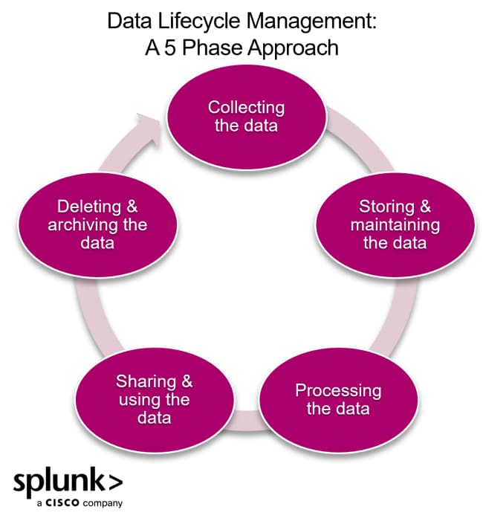
Stages of the Data Lifecycle
Data Creation/Collection – Data is generated from transactions, systems, sensors, or user input
Data Storage – Data is stored in databases, data warehouses, or cloud storage
Data Processing – Data is cleaned, validated, and transformed for analysis
Data Usage – Data is accessed for reporting, analytics, and decision-making
Each stage ensures that data remains accurate, accessible, and useful.

Slide 35
Data Maintenance and Security
Data Sharing & Integration
Data is shared across departments and systems
APIs and integration tools enable smooth data flow
Data Maintenance
Regular updates and backups
Data quality checks and error correction
Data Security
Access control and authentication
Encryption and monitoring
Protection against data loss or cyber threats

Slide 36
Data Archiving and Disposal
Data Archiving
Older or less-used data is moved to low-cost storage
Maintains data for historical analysis or compliance
Data Retention Policies
Define how long data should be kept
Based on legal, business, and regulatory needs
Data Disposal
Secure deletion or destruction of unnecessary data
Prevents misuse and reduces storage costs

Slide 37
2.4 Data Quality and Integrity
Data Quality refers to the accuracy, completeness, consistency, and reliability of data used for analysis and decision-making.
Data Integrity ensures that data remains correct, secure, and unchanged throughout its lifecycle.
Key Dimensions of Data Quality
Accuracy – Data is correct and error-free
Completeness – No missing or incomplete information
Consistency – Same data across systems and sources
Timeliness – Data is up-to-date and available when needed
Validity – Data follows required formats and rules

Slide 38
Maintaining Data Integrity
Data validation and error checks
Access control and user authentication
Regular backups and recovery systems
Encryption and protection from unauthorized changes
Audit trails to track data modifications
Importance
Improves decision-making and analytics
Builds trust in business reports
Ensures regulatory compliance
Reduces operational errors and risks

Slide 39
3. Introduction to Business Analyst.

Slide 40
3.1 Definition and Responsibilities of a Business Analyst.
Definition of a Business Analyst
Who is a Business Analyst (BA)?
A Business Analyst is a professional who identifies business needs and finds technology or process-based solutions to improve organizational performance.
Key Role
Acts as a bridge between business stakeholders and the IT/technical team
Understands business problems and translates them into clear requirements
Helps organizations improve efficiency, productivity, and decision-making

Slide 41
Core Objectives
Analyze business processes and workflows
Identify gaps, risks, and improvement opportunities
Support data-driven decision-making
Ensure solutions align with business goals and strategy

Slide 42
Responsibilities of a Business Analyst
Requirement Management
Gather, analyze, and document business requirements
Create functional specifications and use cases
Stakeholder Communication
Interact with clients, managers, and technical teams
Facilitate meetings, workshops, and presentations
Analysis & Solution Design
Perform data analysis and process modeling
Recommend system or process improvements
Support & Evaluation
Assist in testing and implementation of solutions
Monitor outcomes and ensure business objectives are met

Slide 43
3.2 Key Skills for Business Analysts
1. Analytical & Problem-Solving Skills
Analyze business needs, data, and processes
Identify gaps, risks, and improvement opportunities
Provide practical and data-driven solutions
2. Communication Skills
Clear verbal and written communication
Translate business requirements into technical specifications
Prepare reports, documents, and presentations
3. Requirement Gathering & Management
Conduct interviews, workshops, and stakeholder meetings
Create Business Requirement Documents (BRD) and Functional Requirement Documents (FRD)
Manage requirement changes effectively

Slide 44
4. Business Process Knowledge
Understand organizational workflows and operations
Perform process modeling (flowcharts, BPMN)
Align solutions with business goals and strategy
5. Technical Understanding
Basic knowledge of databases and SQL
Familiarity with Excel, Power BI, or Tableau
Understanding of software development lifecycle (SDLC) and Agile methods
6. Stakeholder & Team Collaboration
Work with business users, developers, and managers
Manage expectations and resolve conflicts
Build strong professional relationships
Conclusion:
A successful Business Analyst combines business knowledge, analytical thinking,
communication, and technical understanding to deliver effective solutions.

Slide 45
3.3 Business Analysis Methodogies
Introduction to Business Analysis Methodologies
What are Business Analysis Methodologies?
Business Analysis methodologies are structured approaches used by Business Analysts to identify business needs, gather requirements, and deliver effective solutions.
Purpose
Improve business processes
Ensure clear and accurate requirements
Reduce project risks
Align solutions with business strategy

Slide 46
Why Methodologies Matter
Provide systematic framework
Improve communication between teams
Increase project success rate
Key Points
Business analysis uses methodologies like Agile and Water fall .
Agile is a flexible, iterative approach focused on continuous feedback and collaboration, while Waterfall is a sequential, linear model that emphasizes thorough upfront planning and distinct, consecutive phases to manage projects.

Slide 47
Waterfall methodology:
Approach: A linear, sequential process where each phase must be completed before the next begins.
Phases: Typically includes requirements gathering, design, implementation, verification, and maintenance.
Best for: Projects with stable requirements that are well-defined from the start.
Role of BA in Waterfall
Gather complete requirements at the beginning.
Prepare detailed documentation (BRD, SRS, use cases).
Get sign-off from stakeholders before development starts.
Limited scope for change later.

Slide 48
Advantages
Clear structure and planning.
Good for stable, well-understood requirements.
Strong documentation.
Disadvantages
Not flexible to changes.
Feedback comes late, after development.
Risk of building something that doesn’t match user needs if requirements change.

Slide 49
Agile methodology:
Approach: Iterative and incremental, focusing on flexibility, collaboration, and responding to change.
Key principles: Embraces feedback, breaks work into smaller pieces, and uses short, time-boxed cycles (sprints) to deliver value continuously.
Popular frameworks: Includes Scrum, Kanban, and Lean.
Best for: Projects where requirements may evolve or change, and where continuous feedback is valuable

Slide 50
Role of BA in Agile:
Work closely with Product Owner and development team.
Help write and refine user stories with acceptance criteria.
Participate in:
  Sprint planning
  Daily stand-up meetings
  Sprint review
Continuously prioritize and clarify requirements.
Focus more on communication and collaboration than heavy documentation.

Slide 51
Advantages
Very flexible with changing requirements.
Regular feedback from users.
Delivers working software faster and more frequently.
Disadvantages
Needs high team involvement and collaboration.
Documentation may be lighter.
Difficult if stakeholders are not available regularly

Slide 52
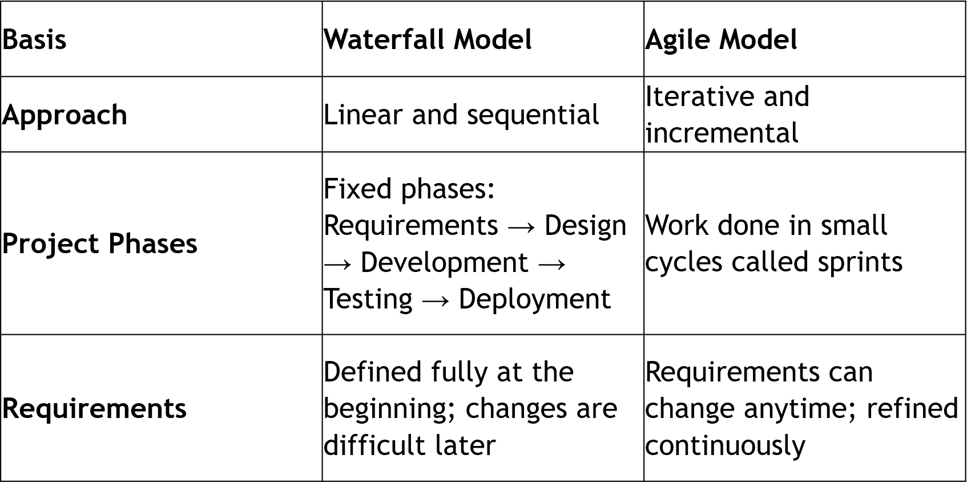
Key Differences Between Waterfall and Agile

Slide 53
3.4 Stakeholder Management
Introduction to Stakeholder Management
What is Stakeholder Management?
Stakeholder Management is the process of identifying, analyzing, engaging, and communicating with individuals or groups who are affected by or can influence a project or business initiative.
Who are Stakeholders?
Internal: Managers, employees, project team, executives
External: Customers, suppliers, partners, regulators, investors

Slide 54
Importance
Ensures stakeholder support and cooperation
Reduces conflicts and misunderstandings
Improves project success and decision-making
Stakeholder Identification and Analysis
Steps in Stakeholder Analysis
Identify Stakeholders – List all individuals or groups involved or impacted
Assess Influence and Interest
  High Power – High Interest: Manage closely
  High Power – Low Interest: Keep satisfied
  Low Power – High Interest: Keep informed
  Low Power – Low Interest: Monitor

Slide 55
Tools Used
Power–Interest Matrix
Stakeholder Register
Communication Plan
Goal:
Understand stakeholder expectations, needs, and potential impact on the project.

Slide 56
Stakeholder Engagement and Communication
Effective Engagement Strategies
Regular meetings and status updates
Clear and transparent communication
Involve stakeholders in decision-making
Address concerns and feedback promptly
Best Practices
Build trust and strong relationships
Manage expectations realistically
Resolve conflicts early
Adapt communication style based on stakeholder needs
Conclusion:
Effective stakeholder management improves collaboration, minimizes risks, and increases the likelihood of successful project outcomes.

Slide 57
4. Data vs. Information

Slide 58
4.1 Distinguishing Raw Data from processed Information
Understanding Raw Data
What is Raw Data?
Raw data is the original, unprocessed facts and figures collected from various sources. It has not been organized, analyzed, or interpreted.
Characteristics
Unstructured or poorly organized
May contain errors, duplicates, or missing values
Difficult to interpret directly
Examples
Sales transaction records
Survey responses
Sensor readings
Website click logs

Slide 59
Key Point:
Raw data is the starting point for analysis but has limited value until processed.
What is Processed Information?
Definition
Processed information is data that has been cleaned, organized, analyzed, and presented in a meaningful way to support decision-making.
Processing Activities
Data cleaning (removing errors and duplicates)
Sorting and organizing
Aggregation and calculation
Data analysis and visualization
Examples
Monthly sales reports
Customer trend analysis
Performance dashboards
Summary charts and graphs

Slide 60
Importance of Transformation
Converts data into actionable insights
Improves decision quality
Enhances business efficiency
Conclusion:
Raw data becomes valuable only after processing, transforming it into meaningful information for analysis and strategic decisions.

Slide 61
4.2 The Transformation process:Data to Information to knowlede
From Data to Information
Data
Raw, unorganized facts and figures
Collected from transactions, surveys, sensors, or systems
Lacks context and meaning on its own
Transformation: Data → Information
Cleaning and validating data
Organizing and structuring
Analyzing and summarizing
Adding context and relevance

Slide 62
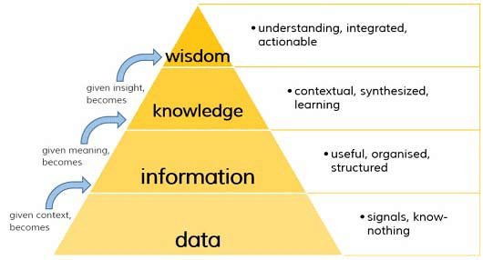
Information
Processed and meaningful data
Provides answers to basic questions (who, what, when, where)
Supports reporting and performance tracking
Example:
Raw sales entries → Total monthly sales report.

Slide 63
4.3 Value of Information in Decision Making
What is the Value of Information?
The value of information lies in its ability to reduce uncertainty, improve
understanding, and support better business decisions.
How Information Adds Value
Provides accurate and timely insights
Helps identify trends, risks, and opportunities
Supports planning, forecasting, and strategy
Improves operational efficiency and performance
Benefits in Decision Making
Reduces guesswork and uncertainty
Enables faster and more confident decisions
Minimizes risks and potential losses
Enhances problem-solving and resource allocation

Slide 64
Characteristics of Valuable Information
Accurate and reliable
Relevant to the decision context
Timely and up-to-date
Clear and easy to understand
Example
Sales performance data helps managers adjust pricing, inventory, or marketing strategies.
Conclusion:
High-quality information empowers organizations to make informed, timely, and effective decisions that improve overall business outcomes.

Slide 65
5. Overview of Data-Driven Decision Making

Slide 66
Introduction to Data-Driven Decision Making
What is Data-Driven Decision Making (DDDM)?
Data-Driven Decision Making is the practice of using data analysis and evidence to guide business decisions instead of relying only on intuition or experience.
Key Idea
Collect relevant data
Analyze it to find insights
Use insights to support actions and strategies
Importance
Improves accuracy and objectivity
Helps organizations respond quickly to changes
Supports better planning and performance improvement

Slide 67
5.1 Principles of Data-Driven Decision Making
Core Principles
Evidence-Based Decisions – Decisions supported by facts and analysis
Data Quality – Accurate, complete, and reliable data is essential
Relevance – Use data that directly relates to the business problem
Timeliness – Decisions require up-to-date information
Continuous Improvement – Monitor results and refine decisions over time
Focus:
Use data as a strategic asset to guide actions and measure outcomes.

Slide 68
5.2 Benefits of Using Data for Decisions
Reduces uncertainty and guesswork
Improves operational efficiency and productivity
Identifies trends, patterns, and opportunities
Enhances customer understanding and satisfaction
Supports better risk management
Enables faster and more confident decision-making
Improves competitive advantage
Example:
Analyzing customer purchase data to optimize inventory and marketing campaigns.

Slide 69
5.3 Steps in the Data-Driven Decision Process
Define the Problem or Objective
Collect Relevant Data (internal and external sources)
Clean and Prepare the Data
Analyze and Interpret the Data
Generate Insights and Alternatives
Make and Implement the Decision
Monitor Results and Improve
Goal:
Turn raw data into actionable insights that drive measurable outcomes.

Slide 70
5.4 Challenges and Pitfalls in Data-Driven Approaches
Poor data quality or incomplete data
Lack of proper tools or technical skills
Data overload and misinterpretation
Bias in data or analysis
Privacy and security concerns
Resistance to change within the organization
Over-reliance on data without business context
Conclusion:
While data-driven decision making improves accuracy and performance, success depends on good data quality, proper analysis, and balanced business judgment.

Slide 71
6. Case Discussions/ Real- Life Examples

Slide 72
6.1 Analysis of Business Scenaries
Scenario analysis in business is the process of creating and evaluating different possible future situations (scenarios) — such as best case, worst case, and most likely case — to understand their impact on the organization and make better decisions.
Purpose of Scenario Analysis:
To anticipate risks and opportunities
To see how changes in key factors (price, demand, cost, interest rates, etc.) will affect profit, cash flow, growth, etc.
To support strategic planning and decision-making
To avoid being shocked by sudden changes in the market or environment

Slide 73
Examples:
1. Sales Revenue Scenario
Business Question:
“What happens to our profit if sales go up or down?”
Scenarios:
Best-case: Sales increase by 30%
Most-likely: Sales increase by 10%
Worst-case: Sales decrease by 15%
Analysis:
The company calculates revenue and profit under each scenario and decides:
How much stock to buy
Whether to hire more staff
Whether to offer discounts
Helps in sales planning and budgeting.

Slide 74
2. New Product Launch Scenario
Business Question:
“Should we launch a new product next year?”
Scenarios:
Best-case: High customer demand, low competition → high profit
Most-likely: Moderate demand → average profit
Worst-case: Low demand, high marketing cost → loss
Analysis:
The business estimates:
Expected sales
Marketing cost
Production cost
Then decides whether to proceed, delay, or cancel the product launch.
Helps in strategic decision-making.

Slide 75
Key aspects of scenario analysis:
Evaluates multiple futures: Instead of relying on a single forecast, scenario analysis explores a range of potential outcomes by changing key assumptions about variables like interest rates, market demand, or operating costs.
Identifies risks and opportunities: It helps businesses anticipate both negative events (like a sudden increase in raw material costs) and positive ones (like a surge in market demand).
Supports decision-making: By providing a clearer picture of potential outcomes, it helps leaders make more robust decisions about investments, operations, and strategy.
Develops contingency plans: The analysis allows companies to create actionable plans for different scenarios, so they are better prepared to react to unexpected events.
Focuses on comprehensive change: Unlike sensitivity analysis, which often changes one variable at a time, scenario analysis changes multiple variables simultaneously to create more comprehensive future scenarios.

Slide 76
How it is used:
Financial planning: It can be used to forecast the potential impact on cash flow and business value.
Risk management: It helps identify and mitigate potential risks associated with various external factors.
Strategic initiatives: It provides a framework for developing long-term strategies and evaluating potential courses of action.
Investment decisions: It can be used to evaluate the potential returns and risks of major investments.

Slide 77
7. Introduction to Data Governance & Data Ethics

Slide 78
7.1 What is Data Governance?
Data Governance is a framework for managing data as a valuable organizational asset.
It ensures data is accurate, consistent, secure, and available for decision-making.
Aligns data management with business goals, compliance requirements, and risk management.
Covers data quality, data security, privacy, lifecycle management, and standards.
Helps organizations build trust in data for analytics, reporting, and operations.

Slide 79
Data Governance Policies and Procedures
Establish data quality standards to ensure accuracy, completeness, and reliability.
Define data access and security policies to protect sensitive and confidential information.
Implement data classification (public, internal, confidential, restricted).
Set procedures for data collection, storage, sharing, retention, and disposal.
Ensure compliance with legal and regulatory requirements (privacy, audit, industry standards).
Maintain documentation and audit trails for accountability and transparency.

Slide 80
Roles and Responsibilities in Data Governance
Chief Data Officer (CDO): Leads data strategy and governance initiatives.
Data Owners: Accountable for data quality, security, and business value.
Data Stewards: Manage day-to-day data quality, standards, and metadata.
IT Team: Implements data infrastructure, security controls, and system integration.
Data Users: Follow governance policies and use data responsibly.
Governance Committee: Defines policies, resolves data issues, and ensures alignment with business objectives.

Slide 81
7.2 Principles of Data Ethics, Privacy, Transparency, and Accountability
Data Ethics: Collect and use data responsibly, ensuring fairness, avoiding bias, and preventing misuse or harm to individuals and communities.
Privacy Protection: Respect individuals’ personal information by collecting only necessary data and safeguarding it from unauthorized access.
Confidentiality: Ensure sensitive data is securely stored, shared only with authorized users, and protected through encryption and access controls.
Transparency: Clearly communicate how data is collected, used, stored, and shared to build trust with users and stakeholders.
Informed Consent: Obtain permission from individuals before collecting or processing their personal data.
Accountability: Establish clear responsibilities, monitor data practices, conduct audits, and ensure compliance with legal and ethical standards.
Trust and Compliance: Follow data protection regulations and promote a culture of ethical data use across the organization.

Slide 82
7.3 Regulatory Compliance – GDPR and CCPA
Regulatory Compliance ensures organizations handle personal data responsibly and follow legal requirements for data protection and privacy.
GDPR (General Data Protection Regulation) – European Union law that protects personal data and privacy of individuals.
  Requires lawful data processing, user consent, and strong data security.
  Provides rights such as data access, correction, portability, and the “right to be forgotten.”
  Mandates breach notification and imposes significant penalties for non-compliance.
CCPA (California Consumer Privacy Act) – Protects the privacy rights of California residents.
  Gives consumers the right to know what personal data is collected and how it is used.
  Allows individuals to request data deletion and opt out of the sale of personal information.
Business Impact: Organizations must implement data governance, transparency, security controls, and compliance processes to avoid legal risks and build customer trust.

Slide 83
7.4 Building a Culture of Responsible Data Use
Leadership Commitment: Top management must demonstrate ethical data behavior and prioritize privacy, security, and compliance.
Clear Governance Framework: Establish strong data governance policies, standards, and procedures that guide data handling across the organization.
Employee Training & Awareness: Conduct regular training on data ethics, cybersecurity, privacy regulations, and responsible data sharing.
Defined Roles & Accountability: Assign clear responsibilities to data owners, data stewards, IT teams, and business users.
Data Minimization & Purpose Limitation: Collect only necessary data and use it strictly for defined business purposes.
Secure-by-Design Systems: Embed privacy and security controls into technology, processes, and product development from the beginning.
Encourage Ethical Reporting: Create a safe environment for reporting data misuse, risks, or breaches.

Slide 84
Monitoring, Improvement
Continuous Monitoring: Regularly audit data practices, monitor compliance, and assess data quality and security controls.
Transparency & Communication: Clearly inform stakeholders how data is collected, used, stored, and protected.
Adaptability: Update policies and practices to respond to new technologies, cyber threats, and regulatory changes.
Performance Measurement: Use key performance indicators (KPIs) to track responsible data use and improvement over time.
Conclusion:
Building a culture of responsible data use is not a one-time initiative but an ongoing commitment. By integrating ethical principles, accountability, strong governance, and continuous improvement, organizations can protect stakeholder trust, reduce risks, ensure compliance, and maximize the strategic value of data.

Slide 85
THANK YOU

